Slide 1
FOOD ORDERING SYSTEM
610557 Munkhzorig Bayartosgt
610561 Tuvshintur Batzorig
610567 Davaaabayar Battogtokh
610526 Odbayar Nanjidjamts
961800 Manduul Enkhee
MUM CS472-2019-11A-11D
1
Maharishi University of Management
Notes:
1

Slide 2
1. Problem scenario
As title says our project is going to be food ordering website using java servlet and jsp. In this website you can select your desired food from the menu and put it in your order list. There will be two types of user. Admin user which will manage user orders and creating menu set. And there will be registered users which is capable of ordering food from our website.
Our main features will be food types and calculated calories.

Slide 3
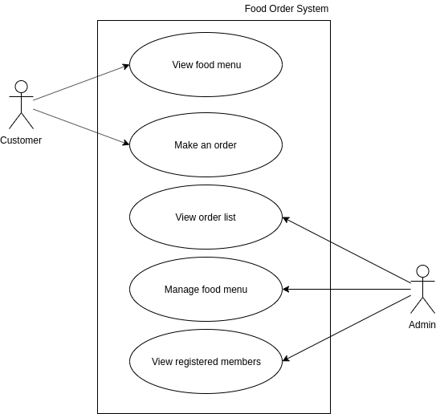
2.Use case diagram
3

Slide 4
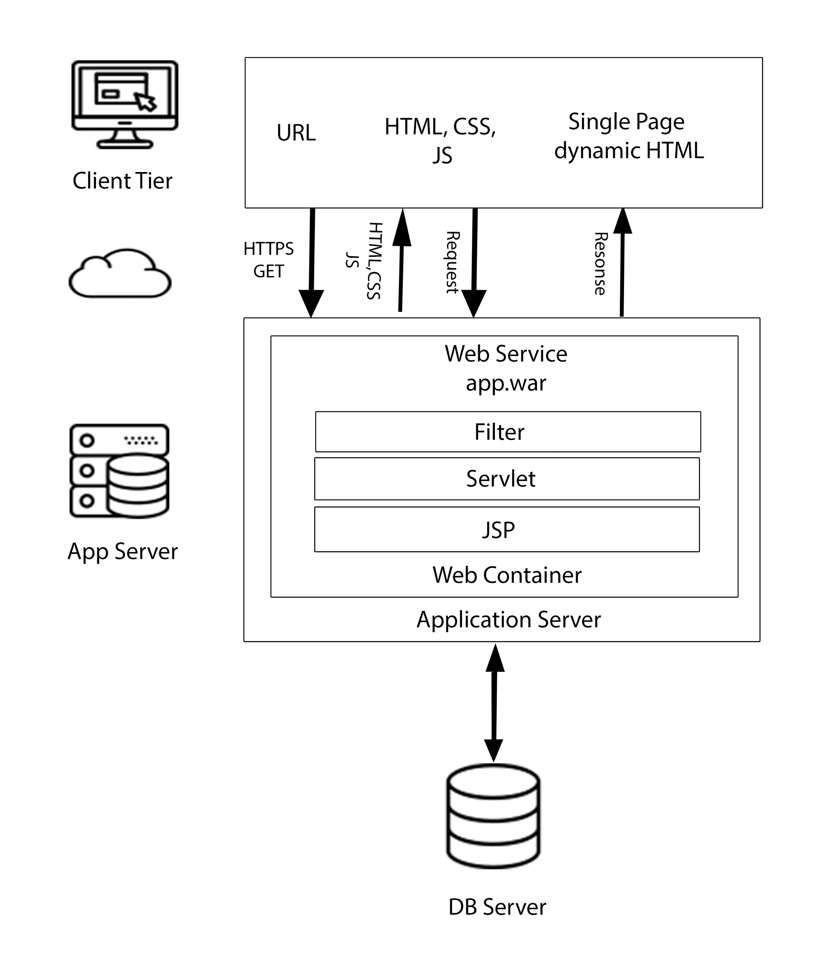
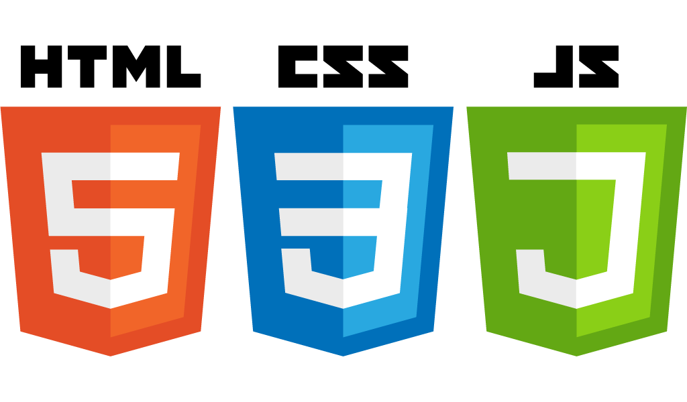


3. High level architecture & Technologies used
4

Slide 5
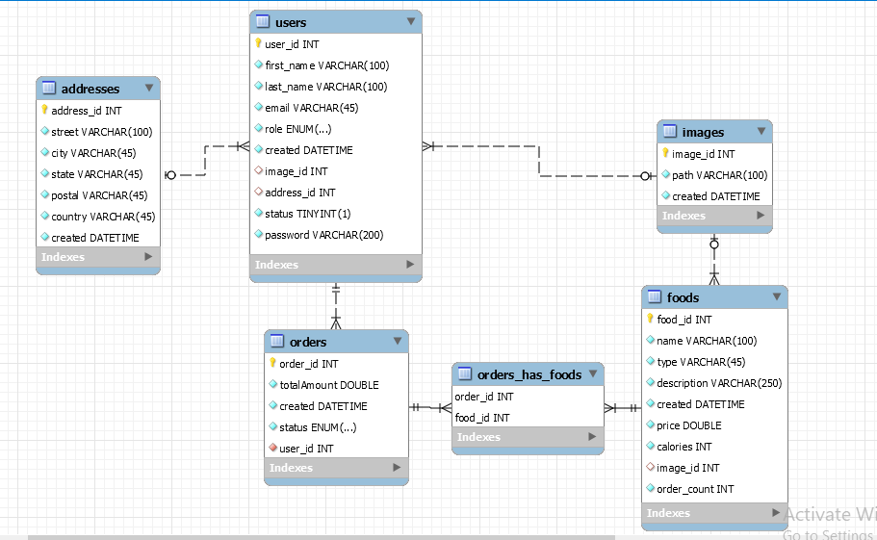
4. Key abstractions vs ERD
Foods
Users
Addresses
Orders
Orders_Has_foods
Images
5

Slide 6
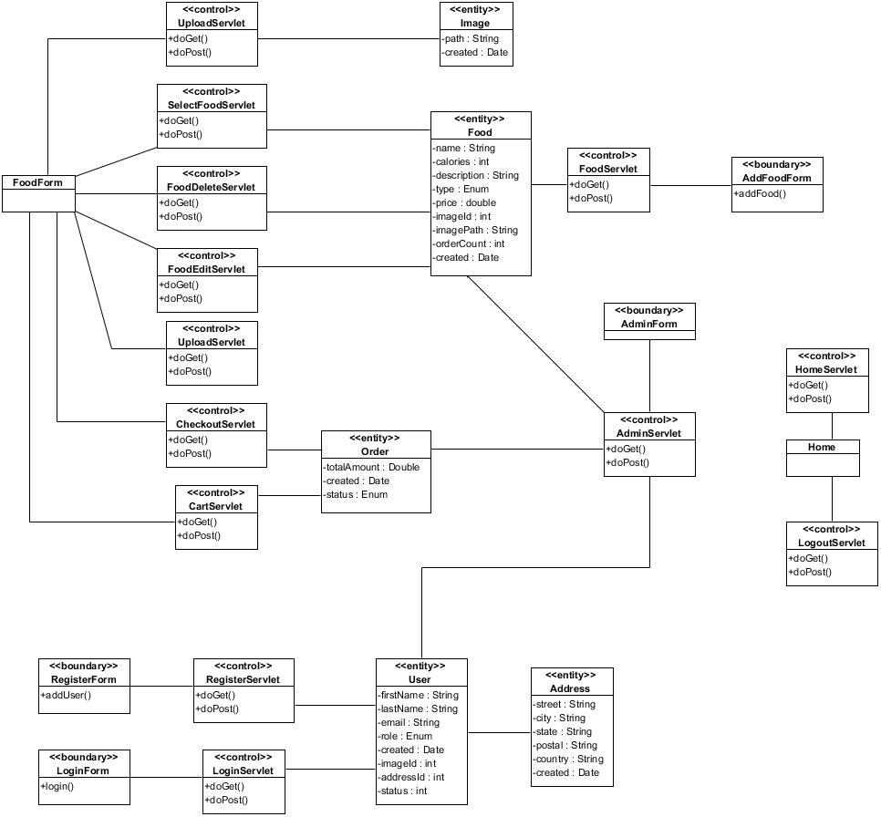
5. Class Diagram
6

Slide 7
Thank you
Get a little bit of better
every single day.
MUM CS472-2019-11A-11D
7
Maharishi University of Management
Notes:
In Slide Show mode, click the arrow to enter the PowerPoint Getting Started Center.
7

